Slide 1


Capstone Project: Automated Testing Framework
Name : Vishal Pramanik
Batch : 3 Java Selenium

Slide 2

CONTENTS
Project Overview
Objective
Target Applications
Tools and Technology
Key Goals
Project Flow
Framework Approach
Deliverables
Team and Collaboration

Slide 3
Objective
Develop an end-to-end automated testing and CI/CD workflow using:
Selenium WebDriver and TestNG
Jenkins for CI/CD
Git for version control
JIRA for test and defect tracking

Slide 4


Websites
SauceDemo
nopCommerce
Automation Exercise
BStackDemo

Slide 5
Tools and Technology
Technology | Purpose
Java | Programming language
Selenium WebDriver | Browser automation
TestNG | Testing framework
Maven | Dependency & build management
Jira | Test management & defect tracking
Extent Reports | Custom HTML reports
GitHub | Version control
Jenkins | CI/CD automation

Slide 6


Key Goals
Automate functional testing
Use Git/GitHub for version control
Track requirements and bugs in JIRA
Implement Cucumber BDD
Generate ExtentReports with screenshots
Integrate with Jenkins

Slide 7




Project Structure
1
selenium-capstone/
├── pom.xml
├── README.md
├── testng.xml
├── src
│ ├── main
│ │ └── java
│ │ ├── pages
│ │ └── utils
│ │
│ ├── test
│ │ ├── java
│ │ │ ├── runners
│ │ │ └── stepDefinitions
│ │ │
│ │ └── resources
│ │ ├── features
│ │ └── config.properties
│
├── reports
├── target
├── test-output
└── src

Slide 8
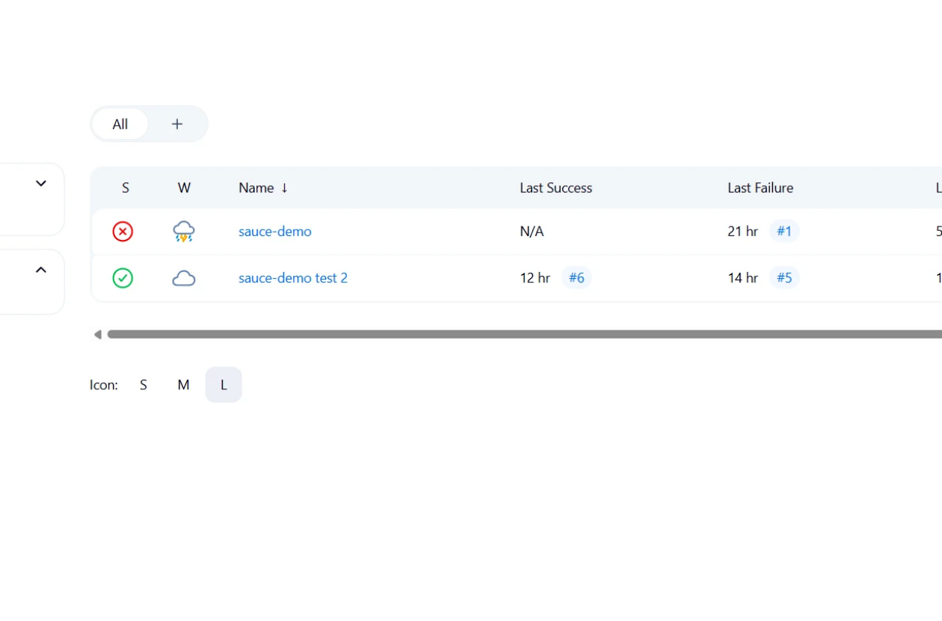
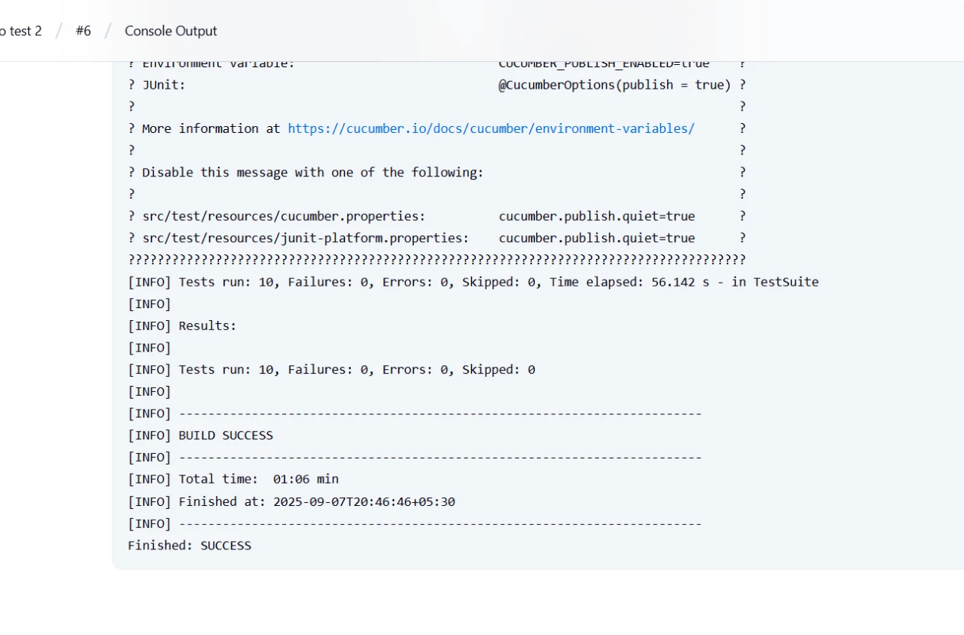
Jenkins Screenshot

Slide 9





Project Flow
1
2
3
Setup
Automation
JIRA
Initialize GitHub repo and project
Develop Selenium scripts
Manage user stories and bugs
4
5
CI/CD
Reporting
Run tests via Jenkins
Analyze ExtentReports

Slide 10







Framework Approach
1
2
3
4
Page Object Model (POM)
TestNG with parallel testing
Cucumber BDD with Gherkin
Data-Driven Testing
5
6
Cross-Browser: Chrome, Firefox
Extent Reports

Slide 11
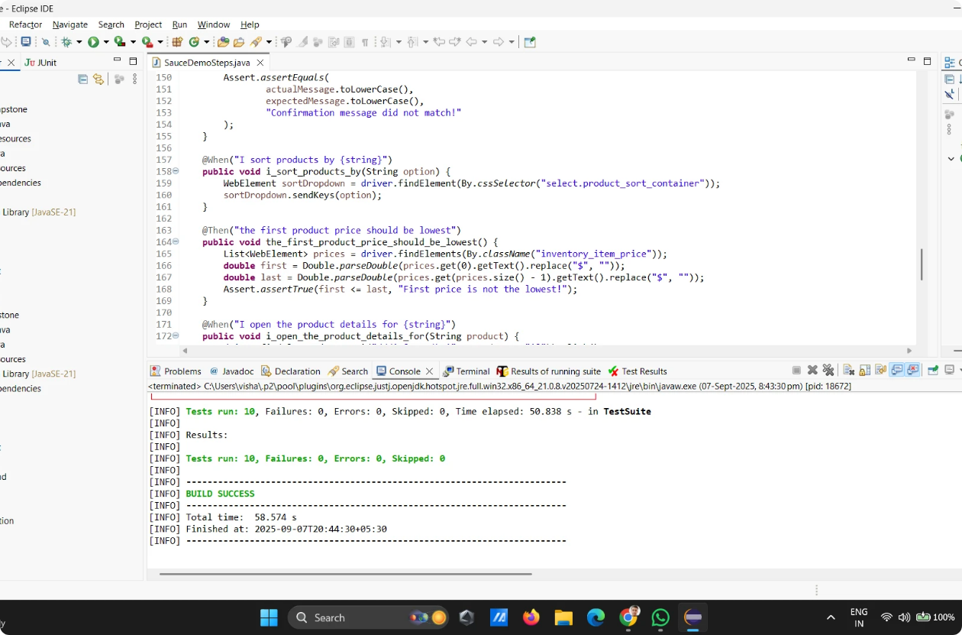
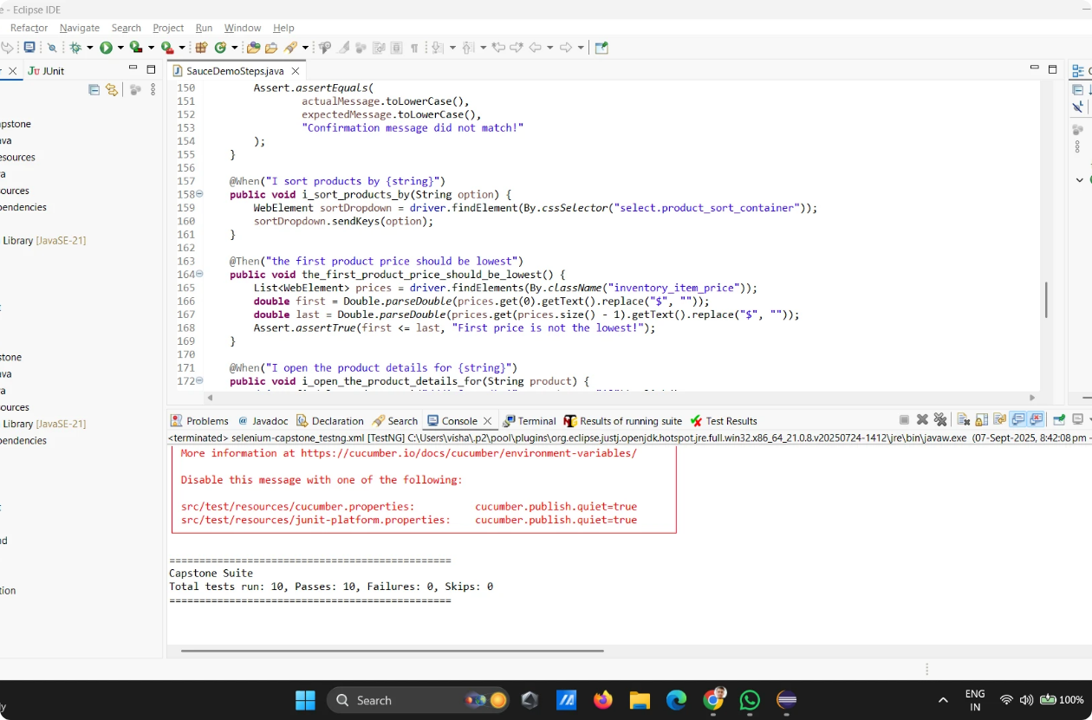
Screenshot of POM.XML
Screenshot of TESTNG.XML

Slide 12
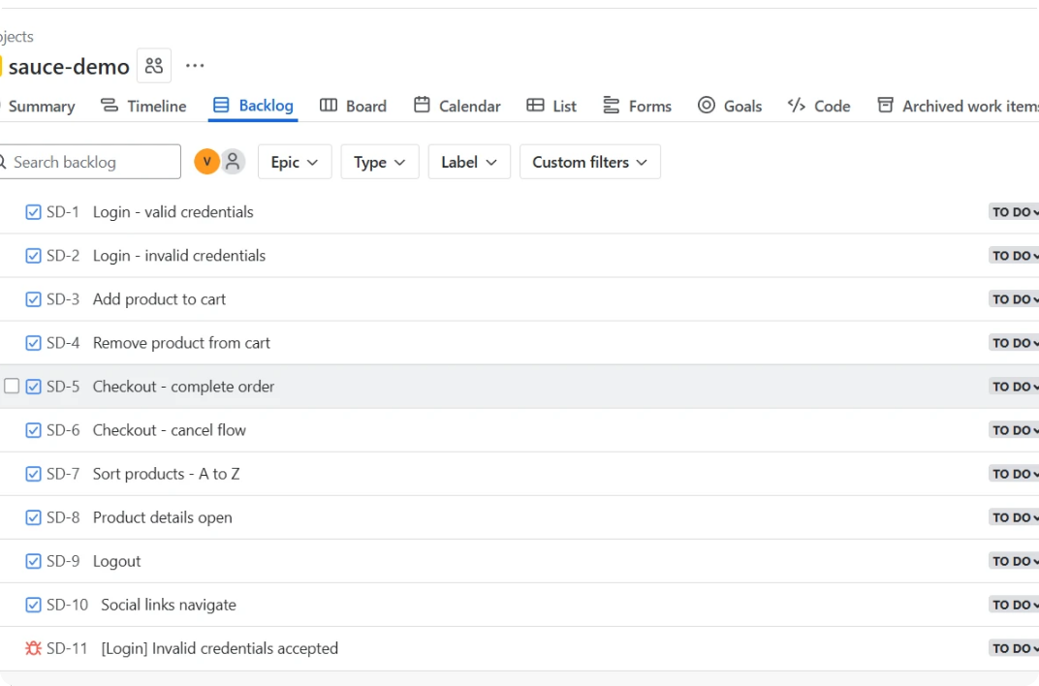
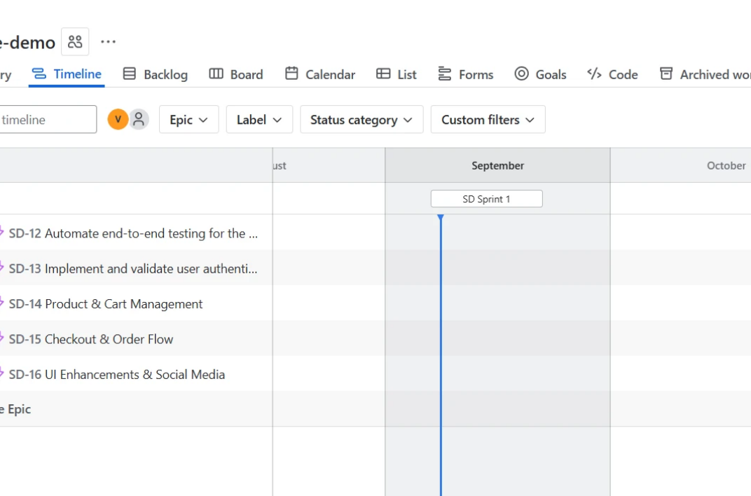
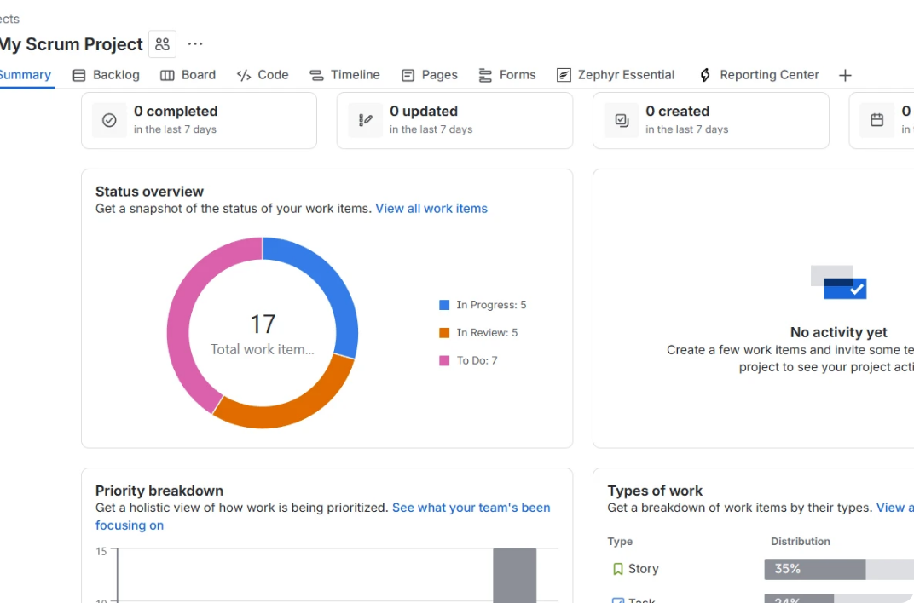
Jira Screenshot
10 Test Case
5 Epics and Bugs
Report

Slide 13






Deliverables
1
2
3
Manual test cases
Automation scripts
Extent Reports with screenshots
4
5
6
Cross-browser results
Screenshots and logs
Zipped project folder

Slide 14
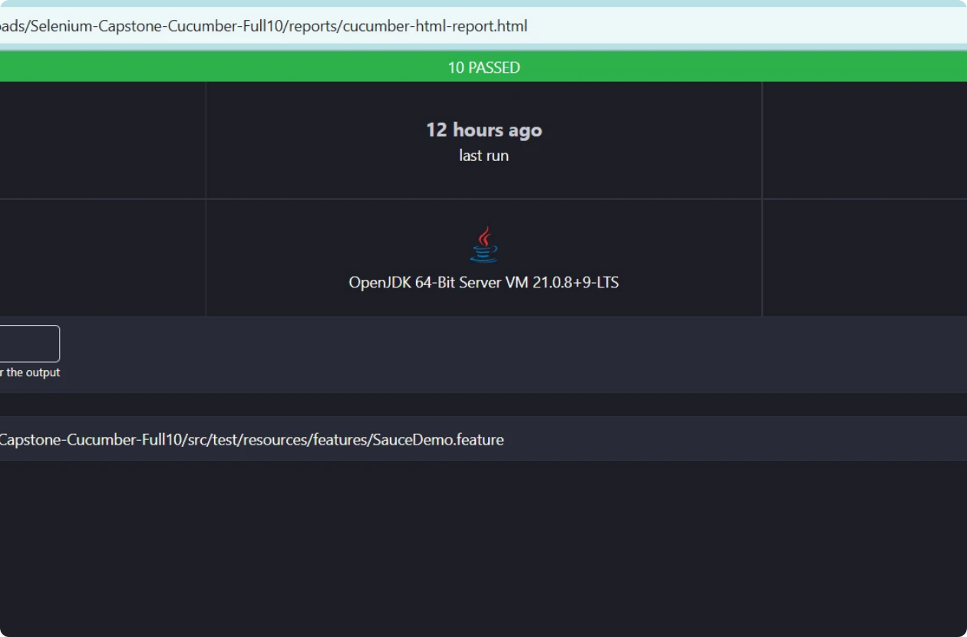
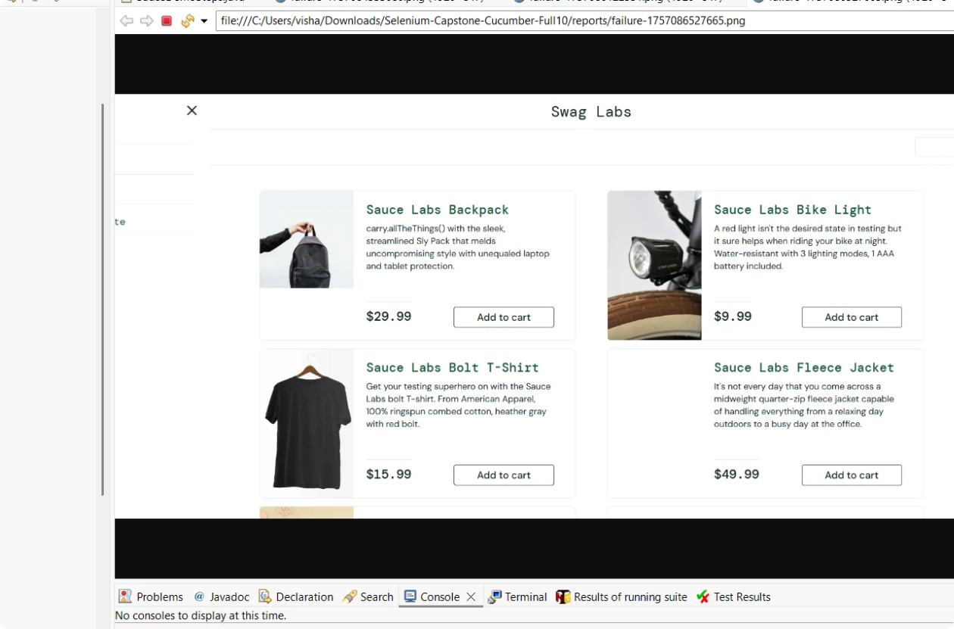
Cucumber-html-Report
Screenshot of failed Test

Slide 15

Thank You

